Slide 1
Admiral IT Fantasy League
Week 1 Tuesday Morning QB

Slide 2
Scores
Team 1 | Score | Record | Team 2 | Score | Record
Team Rosie (RGM) | 114.7 | 1-0 | Kerryon My Wayword Son (KS) | 114.5 | 0-1
Haddonfield Cheetahs (HC) |  |  | Colorado Tegridy Farms (CTF)
Team Pinder (PIND) |  |  | Team Brian (R) | 140.5
Dumpster Fires (Wtf) |  |  | Team Laskowski (LASK)
Philly Pretzels (PHLP) |  |  | Marlton Analytics (Pi)

Slide 3
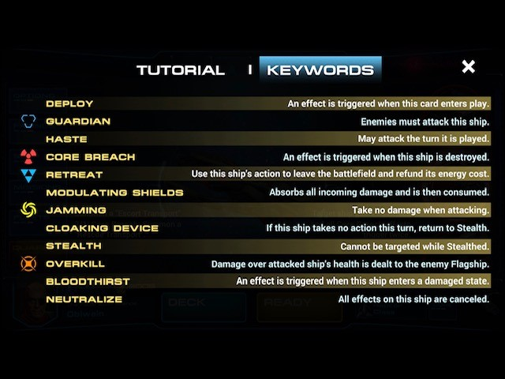
Standings
One
Two
Three
Four
Five
Six
Seven
Eight
Nine
Ten

Slide 4
Tale of the Tape
Team 1 vs Team 2

Slide 5
Tale of the Tape
Team 1 vs Team 2

Slide 6
Tale of the Tape
Team 1 vs Team 2

Slide 7
Tale of the Tape
Team 1 vs Team 2

Slide 8
Tale of the Tape
Team 1 vs Team 2

Slide 9
Trade Summaries

Slide 10
Picks that Paid Off

